Slide 1
            Making the case for multidisciplinary amyloidosis care
            A customizable presentation and toolkit for healthcare professionals looking to advocate for awareness, resources, and funding to establish or improve amyloidosis services

Slide 2
How to use this presentation
About this deck
This deck is a practical awareness and advocacy tool designed to support healthcare professionals in presenting a clear case for improving amyloidosis diagnosis, care pathways, and service provision. It has been developed in collaboration with Professor Marianna Fontana (UK) and Professor Sebastian Spethmann (Germany).
It can be used to:
Inform institutional decision-makers about current gaps in amyloidosis care
Support funding or service development proposals
Encourage the establishment of multidisciplinary team (MDT) care models
The content is intentionally framed to resonate with hospital leadership and decision‑makers.
The deck is modular and customizable, with all elements editable, allowing you to select, adapt, or omit sections depending on your audience and local context.
How to use this presentation
Use it as a template, not a fixed presentation
All titles and examples include bracketed placeholders [ ]
Replace these with the name of your institution, health system, region, or network to reflect local priorities
There is no expectation that every slide will be used in every setting
Refer to the slide notes for guidance about customizing this presentation
1
Tailor content to your audience and objective
Adapt the focus of the presentation depending on who you are presenting to:
Audience | Focus
Hospital leadership | Efficiency, clinical outcomes, cost savings, phased delivery
Policymakers | Population impact, health system gaps, health equity, growing ATTR burden
Clinicians | Diagnostic challenges, benefits of early detection
Community/patient advocacy audiences | Diagnostic delay, disease impact on patient and care partners, care experience
2
Abbreviation: ATTR, transthyretin amyloidosis.

Slide 3
How to use this presentation
Localize the evidence wherever possible
Use local data, estimates, or proxy measures to populate slides on gaps and burden
The data burden collection framework can be used alongside this deck to:
    Gather service‑level metrics
    Capture clinician insights
    Incorporate patient and care partner experience
Where formal data are unavailable, clearly label assumptions
Use the roadmap, timelines, and metrics to
demonstrate feasibility
The service roadmap and timelines are examples,
not prescriptive cases
Adapt these to your specific request
Choose between different approaches to implementation (e.g., phased implementation, or pilot‑and‑scale approaches) depending on local appetite and readiness
Use the measuring success slide to show that the service will be accountable and valuable
3
5
Adapt structure and depth to fit the setting
Reorder, condense, or expand sections based on:
The time available
The decision being sought (awareness, endorsement, funding, pilot approval)
Stakeholder familiarity with amyloidosis
End with a clear call to action
Be explicit about what you are asking for (e.g., endorsement, pilot approval, protected time, coordination support, new diagnostics)
Align the request with stakeholder authority and priorities
Reinforce that the proposed steps are realistic
and scalable
4
6

Slide 4
Adapting amyloidosis service implementation to local context and resource
An effective amyloidosis service can be scaled to suit different levels of resource and infrastructure, allowing institutions to start where they are and build over time.
Resource‑constrained settings
Developing/intermediate service
Established/advanced service
Virtual MDT collaboration using existing teams
Phased implementation, focusing initially on high‑risk, complex cases or specific subtypes (e.g., cardiac ATTR)
Leverage existing infrastructure and pathways, avoiding major upfront investment
Access to diagnostics via external referral or sequencing
Simple referral criteria and red‑flag checklists
Care coordination through a designated clinician or shared responsibility model
Leverage of external expertise where needed
Formal MDT with defined core members and regular meetings
Named coordination role (e.g. specialist nurse or allocated clinician time)
Standardized referral criteria and pathways
Improved access to key diagnostics (on‑site or networked)
Use of simple patient coordination/tracking tools (MDT lists, basic data collection)
Broader case inclusion beyond highest‑risk patients
Fully embedded MDT with governance and reporting structures
Dedicated coordination team and clear ownership of pathways
Integrated care across specialties with aligned clinics and investigations
Strong access to specialist diagnostics and therapies
Routine outcomes tracking and quality improvement
Participation in clinical research
Inclusion in registries and national networks
Formation of ‘hub-and-spoke’ networks with specialist centers supporting local hospitals
Abbreviations: ATTR, transthyretin amyloidosis; MDT, multidisciplinary team.

Slide 5
Contents
Section | What this section contains
Introduction, agenda, and objectives | A concise, adaptable opening framework to set the context for amyloidosis care, outline the purpose of the discussion, and clearly define aims aligned to hospital stakeholder priorities.
The case for specialized MDTs: gaps and unmet needs in amyloidosis | Key messages and evidence points that introduce amyloidosis and highlight why standard care pathways are insufficient for this condition, focusing on unmet clinical and organizational needs. This section supports awareness and creates a compelling rationale for specialist multidisciplinary working.
Understanding the local amyloidosis burden | Guidance and prompts to help users to describe the impact of amyloidosis within their own institution or region, using local or proxy data where available. This section will enable you to translate national or general challenges into locally relevant problems that resonate with hospital leadership, health authorities, and funding bodies.
Amyloidosis service roadmap | This section will help you to describe what an effective amyloidosis service could look like, including core components, MDT functions, and coordination principles. This section is designed to help you to move from problem identification to locally adaptable service solutions that resonate with key stakeholders.
Call to action | Guidance on how to present a focused and credible “ask” to stakeholders, such as funding, approval to proceed, or endorsement of next steps. This section helps learners to translate awareness into decision‑making and action.
Case studies | Examples of successful amyloidosis services that demonstrate the tangible benefits of establishing a coordinated, multidisciplinary approach. These case studies help to illustrate to key stakeholders how multidisciplinary models can improve patient outcomes, service efficiency, and organizational capability, and what impact a similar approach could have in their local setting.

Slide 6

            Establishing a multidisciplinary amyloidosis
            service at [Institution Name]
            A proposal for coordinated specialist care within [Trust/Health System/Region]
Notes:
How you can use this slide: personalize this slide to reflect the aim of the presentation and fill in the placeholders with your local institution. Alternative titles include:
Developing a multidisciplinary amyloidosis service in [organization / ICS / network]
Adapting an integrated care model for local delivery
A proposal for a multidisciplinary amyloidosis service at [Hospital / Center Name]
Improving diagnosis, outcomes, and system efficiency
Improving outcomes and efficiency in amyloidosis care at [Organization Name]
Improving the patient journey for amyloidosis at [Hospital / Network Name]
Establishing a specialist amyloidosis program at [Center Name]
Adapting a multidisciplinary amyloidosis service model for [local context]

Slide 7
Agenda
1
Introduction and objectives
2
Unmet needs in amyloidosis diagnosis and management
3
The case for change at [Institution Name]: why a specialist amyloidosis MDT is necessary
4
Building an amyloidosis MDT at [Institution Name]: implementation, challenges, and roadmap
5
Relevant case studies
6
Call to action
Notes:
How you can use this slide: customize this agenda by inserting local details and adjusting or reordering sections to align with the purpose of your presentation, your stakeholder audience, and local priorities; the example shown reflects the structure of this toolkit.

Slide 8
Objectives
1
Present the case for change in amyloidosis diagnosis and management in [Region/Hospital]
2
Demonstrate the clinical, operational, and strategic need for a multidisciplinary amyloidosis service within [Hospital/Trust/Network]
3
Outline a locally adapted model for delivering coordinated amyloidosis care, including [resource/infrastructure] requirements needed to establish this service
4
Seek [approval/funding/endorsement/agreement to progress] from [Hospital Stakeholder Group]
Notes:
How you can use this slide: these aims should be tailored to your audience and the decision you are seeking. Replace placeholders with accurate local details. Emphasize organizational relevance rather than clinical detail. Keep the final aim explicit about what you want stakeholders to do as a result of this presentation. Use this slide to clearly set expectations and signal that the discussion will focus on solutions and impact, not just clinical background. Add more objectives if you need to; however, try to keep this slide concise and focused on the key outputs you would like to obtain from the discussion.
Other objectives could include:
Increase awareness of amyloidosis and its impact within [Institution / Service Area]
Highlight current challenges and variation in patient pathways at [Hospital Name]
Introduce the concept of a multidisciplinary amyloidosis service
Invite [stakeholder group] to contribute to service design and prioritization
Describe the essential components of an effective multidisciplinary amyloidosis service
Explore how this model could be adapted within [local infrastructure / workforce constraints]
Identify opportunities for integration with existing services at [Institution Name]
Secure strategic support for phased implementation at [Institution / ICS]
Show how a multidisciplinary amyloidosis service aligns with [local strategy /national priorities]
Describe the role of specialist services in improving equity and access

Slide 9
        The case for specialized MDTs: gaps and unmet needs in amyloidosis
Notes:
Section overview: this section can be used to demonstrate general gaps in amyloidosis care and illustrate the need for specialized care. You can use these slides to demonstrate the wider burden of amyloidosis in the absence of local data. The slides in this section can be used to introduce amyloidosis to stakeholders who may not be familiar with the disease.
Instructions: personalize this title slide to reflect the unmet needs in your region and fill in the placeholders with your
local institution.
Alternative titles could include:
“The case for change: multidisciplinary amyloidosis care at [Institution Name]”
“Why [institution name] needs a multidisciplinary amyloidosis service”
“The rationale for an amyloidosis MDT at [Hospital / Trust]”
“Challenges and unmet needs in amyloidosis care at [XXX]”

Slide 10
What is amyloidosis?
Amyloidosis is a group of rare and serious conditions caused by the abnormal accumulation of misfolded proteins (amyloid) in tissues and organs.
Amyloid deposits disrupt normal organ structure and function
The disease is often multisystemic, affecting the heart, kidneys, nerves, and gastrointestinal tract
Symptoms are frequently nonspecific and vary by organ involvement
There are different types of amyloidosis, each requiring distinct diagnostic and treatment approaches
Early diagnosis and coordinated specialist care are critical to improving outcomes
Amyloidosis
AL
amyloidosis
ATTR
AA
amyloidosis
Other types of amyloidosis
ATTRwt
ATTRv
References Cook J, et al. Blood Adv. 2026. doi: 10.1182/bloodadvances.2025017237.
Abbreviations: AA, amyloid A; AL, light chain; ATTR, transthyretin amyloidosis; ATTRwt, wild-type transthyretin amyloidosis; ATTRv, hereditary transthyretin amyloidosis.
Notes:
Slide purpose: this slide is intended to provide hospital stakeholders with a high‑level understanding of amyloidosis, sufficient to appreciate its complexity and why standard care models are often inadequate.
How you can use this slide:
Keep the explanation simple, nontechnical, and concise
Focus on amyloidosis as a rare, multisystem, high‑risk condition, rather than providing detailed pathophysiology
Emphasize features that make care challenging (nonspecific symptoms, multisystem involvement, multiple disease types)
Avoid in-depth clinical detail or treatment algorithms unless appropriate for your audience
This slide should act as a foundation for subsequent discussion of care gaps and the need for a coordinated multidisciplinary approach

Slide 11
Types of amyloidosis
Systemic AL amyloidosis
ATTR
Rare but aggressive form of amyloidosis
Rapid progression and frequent multisystem involvement
Significant mortality, especially with cardiac involvement
Outcomes strongly driven by speed of diagnosis and response to treatment
Delayed recognition leads to high rates of advanced disease at presentation, leading to worsened clinical outcomes, increased emergency admissions, and intensive resource use
Includes ATTRwt (acquired) and ATTRv (hereditary)
ATTRwt is emerging as an underdiagnosed and underestimated cause of heart failure, especially in elderly peoploe
Prevalence is expected to increase with an aging population, increased awareness, and improved detection, leading to rising clinical demand
ATTR is a multisystem disease: patients often present with cardiac involvement, but may also be associated with prior orthopedic conditions (e.g., carpal tunnel syndrome, spinal stenosis), gastrointestinal symptoms, or neuropathy
Diagnosis is frequently delayed or missed, resulting in advanced disease at presentation and poor clinical outcomes
Earlier identification enables treatment with disease‑modifying therapy, which can slow disease progression and reduce downstream
healthcare utilization
References: Cook J, et al. Blood Adv. 2026. doi: 10.1182/bloodadvances.2025017237; Gustine JN, et al. Blood Adv. 2023;7(20):6080–6091; Abdullah N, et al. Blood. 2024;144(Suppl 1):5143; Irabor B, et al. Front Cardiovasc Med. 2022;9:863179; Damy T, et al. Amyloid. 2022;29(3):165–174; Nativi-Nicolau JN, et al. Heart Fail Rev. 2022;27(3):785–793.
Abbreviations: AL, light chain; ATTR, transthyretin amyloidosis; ATTRwt, wild-type transthyretin amyloidosis; ATTRv, hereditary transthyretin amyloidosis.
Notes:
Slide purpose: this slide provides a top‑line introduction to the main types of amyloidosis, highlighting key differences in disease burden and implications for hospital care. Its purpose is to give leaders sufficient context to understand why coordinated service models are needed.
How you can use this slide:
Use this slide early in the deck to establish a shared baseline understanding of AL amyloidosis and ATTR
Focus on high‑level impact (aggressiveness, diagnostic delay, system burden), not pathophysiology
Avoid in-depth clinical discussion; this slide is intended to frame the problem, not provide teaching
Adapt or remove sections depending on local service focus (e.g., ATTR‑focused centers)
Use this slide to set up subsequent slides on diagnostic gaps, patient impact, and the need for multidisciplinary services

Slide 12
Gaps in AL amyloidosis diagnosis
Average time to diagnosis: 21.7 months
Patients experience significant delays and multiple physician visits
before a diagnosis of amyloidosis is made.
Reference: Lousada I, et al. Adv Ther 2015;32:920–8; Damy T, et al. Amyloid 2022; 29:165–74.
Abbreviations: AL, light chain; mo, months; y, years.
Notes:
Slide purpose: this slide illustrates the significant diagnostic delays and fragmented patient journeys experienced by individuals with AL amyloidosis. It highlights how delayed recognition contributes to worsened outcomes and increased hospital resource use.
How you can use this slide:
Keep explanation simple and assume a non-specialist audience
Use this slide to demonstrate that diagnostic delay in AL amyloidosis is a system‑level issue, characterized by multiple clinician visits and prolonged time to diagnosis
Emphasize the operational impact of late diagnosis, including emergency presentations, intensive inpatient care, and complex treatment needs
Link these findings directly to the need for early referral, red‑flag recognition, and MDT‑led pathways
This slide is optional and may be removed or condensed if your proposed center is primarily focused on ATTR rather than AL amyloidosis

Slide 13
Gaps in ATTR diagnosis
ATTR is an underdiagnosed and underestimated disease:
Condition | Average time to diagnosis
ATTRv with polyneuropathy | 45.6 months
ATTRv with cardiopathy | 31.8 months
ATTRwt | 19.6 months
Misdiagnosis is driven by nonspecific presentation:
Symptoms overlap with common diseases:
      HFpEF
      Hypertensive heart disease
      Aortic stenosis
      Peripheral neuropathy
      Carpal tunnel syndrome
Low sensitivity of routine echocardiography
ATTR is commonly overlooked even when red flags are present
Timely diagnosis is essential to improve outcomes and ensure access to new disease-modifying therapies.
References: Damy T, et al. Amyloid. 2022;29(3):165–174.
Abbreviations: ATTR, transthyretin amyloidosis; ATTRwt, wild-type transthyretin amyloidosis; ATTRv, hereditary transthyretin amyloidosis; HFpEF, heart failure with preserved ejection fraction.
Notes:
Slide purpose: this slide highlights the system‑level gaps in recognizing and diagnosing ATTR.
How you can use this slide:
Use this slide to show that delayed and missed diagnosis is a predictable system issue, not an isolated problem
Emphasize the lengthy time to diagnosis and overlap with common cardiovascular and neurological conditions relevant to hospital services
Link these gaps directly to the need for clear referral pathways, red‑flag recognition, and multidisciplinary coordination
Keep the focus on implications for hospital activity and outcomes, rather than detailed clinical nuance

Slide 14


Amyloidosis from the patient perspective: findings from the ARC community survey
Journey to diagnosis
Barriers to diagnosis
Average MDs seen before accurate diagnosis:
Top three barriers to diagnosis for patients with AL amyloidosis, ATTRwt, and ATTRv:
AL
26% reported misdiagnosis
ATTRv
18% reported trouble getting tested
ATTRwt
14% reported trouble finding a specialist
Although they still reported facing barriers, patients with ATTRwt reported facing fewer barriers than those with AL amyloidosis or ATTRv
>1,200 patients and caregivers across the globe participated in this survey
References: Amyloidosis Research Consortium. ARC 2022 Community Survey Results. Available from: https://arci.org/arc-2022-community-survey/#about (accessed February 15, 2024).
Abbreviations: AL, light chain; ARC, Amyloidosis Research Consortium; ATTRwt, wild-type transthyretin amyloidosis; ATTRv, hereditary transthyretin amyloidosis; MD, medical doctor.
Notes:
Slide purpose: this slide highlights the patient experience of amyloidosis diagnosis, illustrating common delays and barriers that contribute to poor outcomes and increased healthcare utilization. It provides an evidence‑based rationale for why earlier recognition and coordinated care are necessary.
How you can use this slide:
Use this slide to humanize the case for service development, to complement clinical and operational data
Emphasize that diagnostic delay and misdiagnosis are system‑level issues, not individual clinician failings
Link patient‑reported barriers directly to the need for clear referral pathways and multidisciplinary services

Slide 15
Economic and system burden of amyloidosis
on healthcare services
Amyloidosis places a disproportionate burden on hospitals and healthcare systems relative to its rarity:
Delayed diagnosis drives repeated system use
Multiple appointments, investigations, and referrals across specialties
Median ~17 hospital interactions and 3 inpatient admissions
before diagnosis
Patients often present with advanced disease, resulting in higher rates of:
Emergency admissions
Prolonged inpatient stays
Critical care or high‑dependency use
Sharp cost escalation for ATTR-CM: ~€6,800 (NYHA II) → ~€62,900 (NYHA IV), driven by inpatient care
Fragmented care pathways create inefficiency
Duplication of diagnostics (imaging, biopsies, blood tests)
Lack of coordinated oversight of investigations and management
High clinical and treatment burden
~25% of patients with ATTRv require emergency care or hospitalization
Management often involves complex and high‑cost therapies requiring specialist input
Lack of coordination increases risk and cost
Inefficient resource use and treatment delays
Higher complication rates and avoidable readmissions
Ongoing high resource utilization even after diagnosis
Earlier diagnosis improves outcomes and reduces burden
Example from Spain:
~10% absolute reduction in cardiovascular hospitalizations in the first year after diagnosis
~101 hospitalizations avoided per 1,000 patients in year 1
~139 hospitalizations avoided over 5 years (~€640k savings)
Long‑term per‑patient savings of ~€2,000–€3,000 as care becomes more coordinated
A multidisciplinary amyloidosis service creates an opportunity to improve outcomes while using resources more efficiently, rather than adding cost.
References: Formiga F, et al. Expert Rev Pharmacoecon Outcomes Res. 2021;21(5):1127–1133; Hjalte F, et al. Ann Med. 2023;55(2):2292686; Lane T, et al. Circulation. 2019;140(1):16–26.
Abbreviations: ATTR-CM, cardiac transthyretin amyloidosis; ATTRv, hereditary transthyretin amyloidosis; NYHA, New York Heart Association.
Notes:
Slide purpose: this slide is designed to illustrate that amyloidosis is not only a clinical challenge, but also a resource‑intensive and costly condition when managed through fragmented pathways.
How you can use this slide:
Keep the discussion focused on system impact, not detailed health economic modeling
Emphasize how delay, duplication, and unplanned care drive cost and inefficiency
Use local examples or proxies when exact cost data are unavailable (e.g., admissions, length of stay, repeated investigations)
Avoid assigning blame; frame this as a structural issue that coordinated services are designed to address
Key message for stakeholders: a multidisciplinary amyloidosis service creates an opportunity to improve outcomes while using resources more efficiently, rather than adding cost.

Slide 16
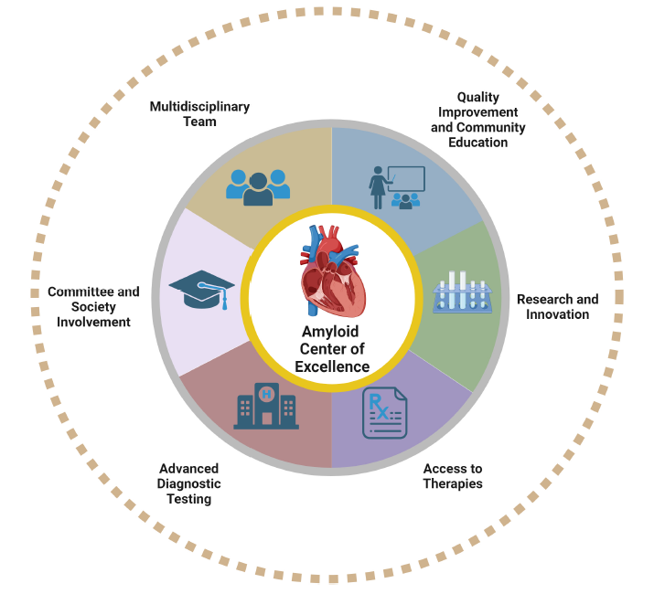
Role of multidisciplinary amyloidosis services
A multidisciplinary amyloidosis service plays a central role
in delivering timely and coordinated care for a multisystem disease.
These services provide:
Early and accurate diagnosis through coordinated assessment and specialist input
Integrated decision‑making across cardiology, hematology, neurology, nephrology, and other relevant specialties
Consistent, evidence‑based management through structured MDT review
Safer use of high‑risk and high‑cost therapies with shared clinical governance
Improved patient experience, with clearer pathways and a single point of coordination
More efficient use of hospital resources, reducing duplication, delay, and unplanned admissions
Participation in clinical research and access to
disease-modifying therapies
References: Sanchorawala V, et al. Amyloid. 2025;32(4):303–308; Cheng R, et al. Heart. 2024;0:1–8. doi:heartjnl-2023-323502; Nativi-Nicolau J, et al. Clin Med Insights Cardiol. 2021;15:11795468211015230. O’Sullivan M, et al. BMC Health Serv Res. 2025;25:415. Image reproduced from Cheng R, et al. Heart. 2024;0:1–8. doi:heartjnl-2023-323502 with
permission from BMJ Publishing Group.
Notes:
Slide purpose: the purpose of this slide is to explain why a multidisciplinary service model is essential for amyloidosis and to show stakeholders how coordinated working directly improves outcomes. It positions the MDT not as an optional enhancement, but as the core mechanism for delivering effective amyloidosis care.
How you can use this slide:
Use this slide to link disease complexity with the need for coordinated service design, rather than isolated specialty care
Emphasize benefits at three levels: patients (earlier diagnosis, clearer pathways), clinicians (shared decisions, reduced burden), and the organization (efficiency, governance, value)
Avoid operational detail and focus on function and impact
Reinforce that multidisciplinary services primarily formalize and improve existing practice, rather than requiring significant new infrastructure
Tailor examples to reflect local pressures (e.g., heart failure admissions, delayed diagnosis, fragmented pathways at [Institution Name])

Slide 17
        Understanding the local amyloidosis burden at [Institution Name]
Notes:
Section overview: this section will help you to summarize the local amyloidosis burden in your region, using available local data, clinician insights, and patient experience to highlight how the disease currently impacts patients and services. You can use the Data burden collection framework (available on the Amyloidosis Action website) to gather and structure this information, which will enable you to translate local evidence into a clear understanding of unmet needs and the case for more coordinated care.
Instructions: personalize this title slide to reflect the unmet needs in your region and fill in the placeholders with your local institution. If you do not have any local data, you can use the slides in the “The case for specialized MDTs: gaps and unmet needs in amyloidosis” section to illustrate general unmet needs related to amyloidosis.

Slide 18
Gaps in amyloidosis care at
[Institution Name]
Metric | Estimate | Data source
Average time from first presentation to confirmed diagnosis | [XX] months | Electronic health records
Proportion of patients diagnosed after emergency admission
Number of specialties seen before diagnosis
Proportion of patients presenting with advanced cardiac involvement
Average length of stay for amyloidosis‑related admissions
Time from diagnosis to treatment initiation
Notes:
Slide purpose: this slide can be used to highlight local gaps in amyloidosis care at your institution, using selected data or proxy measures to demonstrate how current pathways contribute to delayed diagnosis and fragmented care. It is intended as a top‑level summary to support the case for service development.
How you can use this slide:
Use this slide to present a snapshot of local challenges that hospital leaders can readily recognize
Populate the slide using metrics drawn from, or informed by, the data burden collection framework, ensuring consistency and credibility
Delete or amend the content of rows to reflect the data in your hospital/region
Where full data are not yet available, use clearly labeled estimates or proxy measures aligned with the framework
Focus on system‑level gaps, not individual performance
Use this slide as a bridge to explain how a multidisciplinary amyloidosis service would directly address the identified gaps

Slide 19
Physician insights from [Institution Name]
    Qualitative insight 1
Qualitative insight 2
Qualitative insight 3
Qualitative insight 4
Data source: XXX
Notes:
Slide purpose: this slide summarizes clinician perspectives on amyloidosis care at your institution, highlighting perceived challenges and opportunities from those delivering frontline care. Its purpose is to complement quantitative data with experience‑based insights that can inform service design and the need for a coordinated MDT. You can use the survey in the Data burden collection framework (available on the Amyloidosis Action website) to gather these insights.
How you can use this slide:
Use this slide to bring clinician voice and credibility into the discussion with hospital stakeholders
Populate the quotes or findings using insights gathered through the surveys included in the data burden collection framework or from local engagement with key specialties
Focus on themes that reflect system‑level issues (e.g., coordination, referral complexity, diagnostic uncertainty), rather than individual frustrations
Keep insights concise and anonymized

Slide 20
Patient and care partner insights from [Institution Name]
    Qualitative insight 1
Qualitative insight 2
Qualitative insight 3
Qualitative insight 4
Data source: XXX
Notes:
Slide purpose: this slide provides a top‑line view of patient and care partner experiences of amyloidosis care at [Institution Name], highlighting the impact of delayed diagnosis and fragmented pathways. You can use the survey in the Data burden collection framework (available on the Amyloidosis Action website) to gather these insights.
How you can use this slide:
Use this slide to humanize the case for change, reinforcing why improved coordination and earlier diagnosis matter beyond metrics alone
Populate insights using patient and care partner surveys included in the data burden collection framework or from local engagement activities
Focus on themes that reflect system‑level challenges (e.g., navigating multiple services, lack of a single point of contact, diagnostic delay)
Keep insights anonymized and concise
Use this slide to strengthen the link between identified gaps and the value of a multidisciplinary amyloidosis service

Slide 21
Unmet needs and gap analysis
Current state
What is needed
Desired state
Patients currently see physicians across multiple specialties with limited coordination, and typically consult with 3 specialties before a treatment plan is agreed
Protected time for a core MDT and investment for a single coordination role
Coordinated care delivered through a formal MDT, enabling faster diagnosis and timely treatment initiation, and clearer ownership of patient management
Notes:
Slide purpose: this slide can be used to compare the current state of amyloidosis care in your region with the desired future state, identifying the key gaps that prevent progress. Its purpose is to clearly articulate what is missing locally and what changes are required to move toward a more coordinated service.
How you can use this slide:
Populate the current state column using local insights, data, or known challenges (e.g., fragmented pathways, limited coordination)
Use the “What’s needed to get there” column to outline practical enablers (e.g., MDT structure, coordination, protected time) rather than broad ambitions
Present the desired state as a realistic, achievable outcome of these changes.
Set the scene for subsequent requests such as resource requests, implementation planning, or funding discussions

Slide 22
        Amyloidosis service at [Institution Name]: implementation roadmap
Notes:
Section purpose: this section will help you to translate identified gaps and unmet needs into a locally adaptable vision for an effective amyloidosis service. It outlines what the service could look like in practice, for example, core components, MDT functions, and care coordination principles. The goal is to support the move from problem identification to implementable service solutions that resonate with decision‑makers.
Instructions: personalize this section to reflect the proposed ask in your region and fill in the placeholders with your local institution.

Slide 23
Amyloidosis service at [insert location]: objectives and opportunities
Service vision: to deliver timely and coordinated care for patients with suspected or confirmed amyloidosis through phased development of an integrated multidisciplinary pathway.
Core objectives
Phase 1: establish center foundations
Establish a virtual MDT for rapid, coordinated decision‑making
Reduce time to diagnosis through streamlined referral and baseline assessment
Phase 2: formalize MDT structure
Transition to a formalized MDT with defined membership and regular scheduling
Standardize diagnostic work‑up and referral criteria across participating services
Improve time to disease‑modifying treatment via standardized pathways
Core opportunities for this institution:
Improved patient outcomes through faster diagnosis/earlier MDT input
More efficient use of beds and emergency services
Operational efficiency across multiple disciplines
Enhanced institutional reputation and specialist profile as expertise becomes formalized
Proactive service design positions the hospital ahead of rising demand
Notes:
Slide purpose: this slide clarifies what the amyloidosis service is aiming to achieve and why it matters to the institution. It is designed to align the clinical objectives of the service with strategic and operational opportunities for the hospital.
How you can use this slide:
Use the left‑hand column to populate the core objectives of the amyloidosis service
Use the right‑hand column to highlight the opportunities and benefits for the hospital and stakeholders, such as efficiency, governance, reputation, and future readiness
Ensure objectives and opportunities clearly mirror one another, showing how service goals translate into institutional value
Adapt or prioritize content to reflect local strategy and stakeholder interests – for example, you can consider a phased approach to center establishment to reassure stakeholders that buy-in does not need to happen all at once
Use this slide to set up subsequent discussion around implementation and resources

Slide 24
Building the multidisciplinary care team
Core team
Cardiologist
Neurologist
Hematologist
Ophthalmologist
Geneticist
Care coordinator/nurse navigator
Extended team
Nephrologist
Pharmacist
Psychologist
Gastroenterologist
Occupational therapist
Registered dietician
Urologist
Orthopedist
Notes:
Slide purpose: this slide illustrates the multidisciplinary structure required to deliver effective amyloidosis care, distinguishing between a core team essential for day‑to‑day service delivery and an extended team that provides additional specialist support as needed. Adapt the team composition to reflect local expertise and disease burden (e.g., remove or add specialties as appropriate).
How you can use this slide:
Emphasize that the core team represents the necessary specialties required to establish the service, and can often be drawn from existing roles by implementing protected MDT time
Explain that the extended team provides access to additional expertise without requiring full‑time involvement from all specialties
Reinforce that not all roles need to be recruited immediately; participation can be formalized through agreed referral pathways and MDT input

Slide 25
Moving toward centralized care coordination
The amyloidosis center will deliver multidisciplinary care through formalized coordination:
Establishing a formal amyloidosis MDT structure
Defined core membership (e.g., cardiology, hematology,
imaging, nephrology, neurology, pathology, pharmacy)
Agreed terms of reference and governance structure
Creating a single, coordinated point of care
A designated coordinator (specialist nurse) to manage referrals and pathway navigation
Central oversight of investigations and follow‑up
Shared electronic patient records
Standardizing referral and diagnostic pathways
Clear referral criteria and escalation for suspected amyloidosis
Standardized diagnostic bundles
Coordinated diagnostic work‑up to reduce duplication and delay
Embedding structured MDT decision‑making
Regular MDT meetings for diagnostic confirmation and treatment planning
Documented, consensus‑based care plans with
assigned responsibilities
Cultivating communication and accountability
Clear ownership of patient management across specialties
Consistent communication with patients and referring clinicians/services
Linking care delivery to governance and outcomes monitoring
Review of pathway performance and outcomes
Continuous service improvement over time
Notes:
Slide purpose: this slide answers the key stakeholder question: “How will the service actually work day‑to‑day?” It should reassure leaders that the proposed center is operationally credible and deliverable. You should tailor examples to reflect existing services and structures at [Institution Name]. Emphasize that centralization refers to coordination and oversight, not necessarily centralizing all care delivery in one physical location.
How you can use this slide:
Emphasize that centralized care coordination is about structure and defined processes, rather than creating unnecessary complexity
Frame the model as a way of formalizing and improving work that already occurs, rather than adding parallel systems
Highlight how coordination drives efficiency, safety, and accountability

Slide 26
Amyloidosis service implementation pathway
Resource
Implementation
Awareness
Sustain
Estimate institutional needs and benefits
Recruit a dedicated group of experts, including a nurse navigator
Provide dedicated infrastructure for multidisciplinary meetings and communication
Implement diagnostic algorithm
Create and disseminate red-flag checklists
Organize weekly/biweekly MDT meetings
Educate key specialties on red‑flag features and referral pathways by disseminating checklists
Raise awareness across cardiology, general medicine, imaging, nephrology, and neurology, through short, focused education sessions
Communicate the amyloidosis service model and referral route clearly in departmental meetings
Reinforce consistent use of pathways and MDT review
Continue to raise awareness and
refresh education
Monitor service activity, outcomes, and
pathway performance
Review and refine
MDT processes
and referral criteria
Embed the service within routine audit and reporting process to optimizee outcomes
Notes:
Slide purpose: this slide outlines a practical, phased pathway for establishing and embedding an amyloidosis service, showing hospital stakeholders that implementation is structured and sustainable. It demonstrates how the service can progress from initial resourcing to long‑term delivery.
How you can use this slide:
Use this slide to reassure stakeholders that service development can be phased and managed sensibly
Emphasize that early phases largely build on existing staff and systems, rather than requiring major upfront investment
Adapt each stage to reflect your local priorities
Use the pathway to frame discussions about funding, timelines, and next steps
Position sustainability as an ongoing process of refining services, rather than a one‑off launch

Slide 27
Example timelines: phased implementation
0–3 months
3–6 months
6–12 months
Confirm service scope and clinical leadership
Agree core MDT membership and governance
Identify coordination role (e.g., specialist nurse or designated clinician time)
Map existing referral routes and diagnostic pathways
Launch weekly/biweekly MDT meetings
Introduce diagnostic algorithm and red‑flag checklists
Begin centralized triage
of referrals
Communicate referral pathway across
key specialties
Expand awareness activity across
the hospital
Review early outcomes (time to diagnosis,
MDT volumes)
Refine pathways based on operational learning
Formalize reporting and audit processes
Notes:
Slide purpose: this slide provides example timelines to illustrate how an amyloidosis service can be implemented in a phased and manageable way. Its purpose is to show that service development does not need to be all‑or‑nothing and can progress at a pace that reflects local capacity and priorities.
How you can use this slide:
Use this slide to demonstrate that implementation can be staged over time, with early progress made before the service is
fully mature
Adapt the phases, activities, and time frames to reflect your local context
Use the timeline to support discussions around phased funding/support or incremental scale‑up
An alternative model for implementation is shown on the next slide. You can choose which slide to use based on your local needs

Slide 28
Example timelines: pilot and scale
0–3 months
3–6 months
Limit MDT review to high‑risk or
complex cases
Use existing staff and clinic capacity
Track a small number of core metrics
Expand referral criteria and case volume
Strengthen coordination support by recruiting a nurse coordinator
Formalize service within governance structures
Notes:
Slide purpose: this slide illustrates a low‑risk, pilot‑and‑scale approach to developing an amyloidosis service. Its purpose is to demonstrate feasibility to stakeholders who are cautious about commitment or cost.
How you can use this slide:
Use this slide when engaging more cautious or resource‑constrained stakeholders to show that service development can
start small
Emphasize that the pilot phase uses existing staff and capacity, focusing only on high‑risk or complex cases
Highlight that early tracking of a small number of core metrics allows impact to be assessed quickly and transparently
Frame the scale‑up phase as conditional on learning and evidence
Adapt timelines and scope to suit local needs/realities

Slide 29
Challenges and opportunities at
[Institution Name]
Challenges | Opportunities
Recruiting and retaining specialist staff | Positioning the center as a specialist service of excellence, supporting staff retention through defined roles and professional development
High‑cost specialized technologies for diagnosis and monitoring | Standardizing pathways and MDT oversight enable more appropriate and targeted use of diagnostics, improving value and reducing duplication of tests
Limited local experience with amyloidosis | Partnering with [insert established amyloidosis center] for mentorship
Rarity of amyloidosis/concerns regarding volume of patients using the service | Concentrating referrals through a coordinated pathway makes previously dispersed cases visible
Costs of establishing a new service and MDT | Although the model requires initial investment, it is likely to be cost‑saving in the longer term by shifting care away from unplanned admissions and inefficient pathways Not all institutions need to establish a standalone amyloidosis center; services can initially be developed in a scalable way (e.g., via virtual MDTs, starting with complex cases) and expanded over time into more formalized structures as demand and expertise grow
Notes:
Slide purpose: this slide presents a balanced view of the key challenges associated with establishing an amyloidosis service alongside the practical opportunities and benefits for the institution. Its purpose is to demonstrate that anticipated challenges are understood and manageable.
How you can use this slide:
Adapt or prioritize rows to reflect local stakeholder concerns (e.g., workforce, cost, volume, expertise).
Emphasize that many opportunities involve better coordination and use of existing resources, rather than major new infrastructure
Walk through the challenges column first to demonstrate credibility and realism, then use the opportunities column to show how each challenge can be addressed through service design rather than additional burden

Slide 30
Measuring success at [Institution Name]
Success of the amyloidosis service can be monitored using a variety of indicators:
Early diagnosis and care coordination
Time from referral to confirmed diagnosis
Proportion of patients reviewed through MDT
Time from MDT decision to treatment initiation
Number of specialties seen before diagnosis
Clinical and patient outcomes
Reduction in advanced disease at presentation
Unplanned admissions related to amyloidosis
Patient‑reported experience of care coordination
Operational and organizational impact
Emergency admissions and length of stay
Duplication of investigations across services
Use of high‑cost diagnostics and therapies with MDT oversight
Service sustainability and maturity
Referral volumes and case mix over time
Participation of core specialties in MDT
Completion of audit and reporting cycles
Notes:
Slide purpose: this slide demonstrates that the proposed amyloidosis service will be accountable and measurable. Its purpose is to reassure hospital leadership that success will be tracked and reviewed, and that investment can be linked to tangible improvements in outcomes.
How you can use this slide:
Adapt measures to reflect local priorities and data availability
Use this slide to show that the service is designed with clear success measures from the outset
Emphasize that metrics can be phased, starting with a small number of core indicators and expanding as the service matures
When possible, align measures with the data burden collection framework to ensure consistency and credibility

Slide 31
        Call to action
Notes:
Section overview: this section provides guidance on how to create a focused and credible request to key stakeholders, such as funding, approval to proceed, or endorsement of next steps. This section helps s to translate awareness into decision‑making and action.

Slide 32
Call to action
We are seeking approval to proceed with a coordinated and MDT‑led amyloidosis service using existing infrastructure and a phased investment model.
Endorsement to explore the development of a multidisciplinary amyloidosis service at [Institution Name]
Agreement to establish a working group to scope service design and feasibility
Funding for protected MDT time and a care coordinator role
Approval to formalize an amyloidosis MDT, using existing clinical teams and protected time
Notes:
Slide purpose: this slide is designed to clearly articulate what support, approval, or decision is being sought from hospital stakeholders to progress the development of an amyloidosis service. Its purpose is to move the discussion from awareness and understanding to actionable next steps. Update the slide with your call-to-action statements.
How you can use this slide:
Use this slide to be explicit and focused about your ask; avoid vague requests for “support” without a defined outcome
Select a call to action that matches the maturity of your proposal (e.g., endorsement, funding, approval to pilot, or agreement to proceed)
Tailor the request to your audience’s role and authority (e.g., executive, finance, operations, clinical leadership)
Emphasize that the request is proportionate and achievable, often building on existing infrastructure and workforce
Clearly state what decision is needed now and what the next steps will be if approval is given

Slide 33
        Success stories
Notes:
Section overview: examples of successful amyloidosis services that demonstrate the tangible benefits of establishing a coordinated, multidisciplinary approach. These case studies will help you to illustrate to key stakeholders how multidisciplinary models can improve patient outcomes, service efficiency, and organizational capability, and what impact a similar approach could have in your local setting.

Slide 34
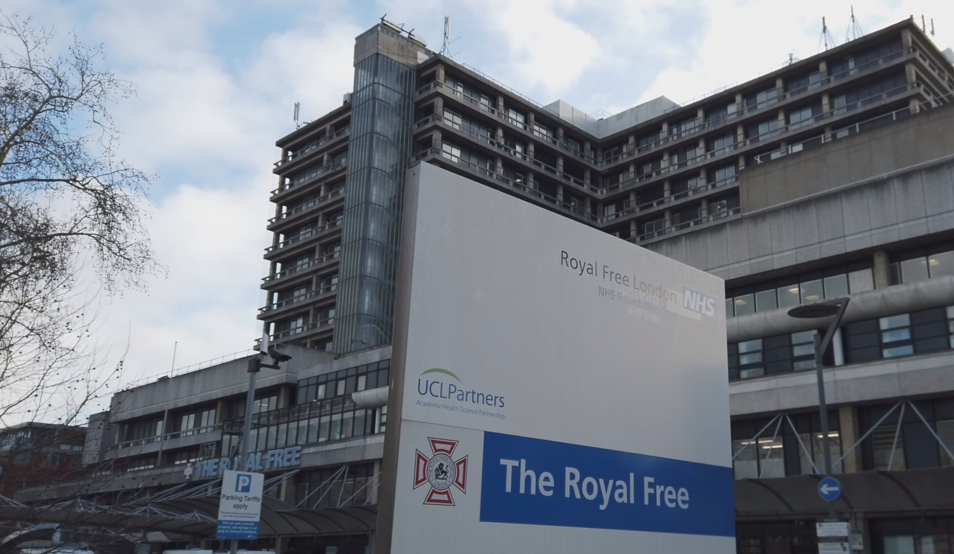

National Amyloidosis Centre: UK
Key features of the center:
Nationally commissioned specialist center providing coordinated care for patients with all forms of systemic amyloidosis
Fully integrated multidisciplinary model including cardiology, hematology, nephrology, neurology, genetics, nuclear medicine, pathology, specialist nursing, and palliative care
One-stop multidisciplinary assessment model with same-day investigations and specialist review
Advanced multimodality imaging infrastructure including echocardiography, CMR,
SAP scintigraphy, and DPD imaging
National expertise in amyloid typing, genetics, and proteomics
Centralized MDT decision-making supporting rapid diagnosis and treatment initiation
Strong integration of clinical care, translational research, and clinical trials
Major international referral and research center with one of the largest amyloidosis clinical trial portfolios worldwide
Coordinates the UK ‘hub-and-spoke’ network of amyloidosis services
Center outcomes:
World’s largest amyloidosis practice → 1,400 new patients per year
Earlier diagnosis and streamlined patient pathways
Reduced fragmentation of care across specialties
Improved access to specialized therapies and clinical trials
Efficient use of highly specialized diagnostics and expertise
Internationally recognized center of excellence and innovation in amyloidosis care
    Click here to watch a video overview of this center and meet the MDT in London
Data source: courtesy of Marianna Fontana (National Amyloidosis Center, UK); Choy CH, et al. Clin Med (Lond). 2024;24(1):100004.
Abbreviations: CMR, cardiac magnetic resonance; DPD, ^{99m}Tc-3,3-diphosphono-1,2-propanodicarboxylic acid; MDT, multidisciplinary team; SAP, serum amyloid P component.

Slide 35
Amyloidosis Center Charité Berlin: Germany
Center establishment timeline:
Dec 2017
Oct 2018
May 2019
Oct 2020
Sept 2024
Project initiation meeting with Charité Foundation
Kickoff symposium
Center opening
Website launch
5-year anniversary
Key features of the center:
Cross-campus, interdisciplinary amyloidosis center in Berlin
Weekly formal MDT meeting for individualized diagnostic and therapeutic decision-making
Organ-specific specialist clinics with coordinated
3–12-monthly longitudinal follow-up
Robust digital architecture of the ACCB registry database (interoperable, integrated with clinical information systems, the biobank, and a patient app)
Run in collaboration with a Clinical Research Unit, permitting participation in national and international clinical trials
Center outcomes
~900 patients in the ACCB registry (~110 with ATTRv)
~200 newly diagnosed patients/year
Now expanding based on success of center → Currently developing a ‘hub-and-spoke’ model in eastern Germany
Data source: courtesy of Sebastian Spethmann (Amyloidosis Center Charité Berlin).
Abbreviations: ACCB, Amyloidosis Center Charité Berlin; ATTRv, hereditary transthyretin amyloidosis; MDT, multidisciplinary team.

Slide 36
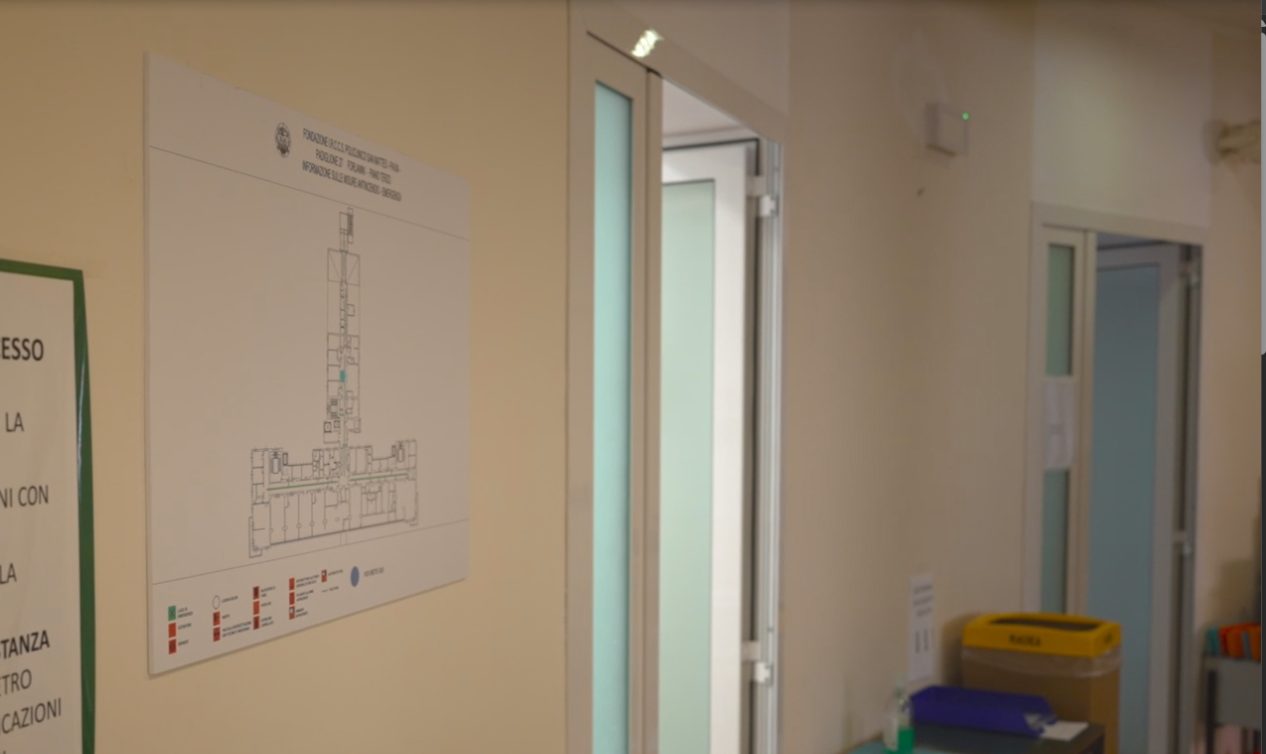
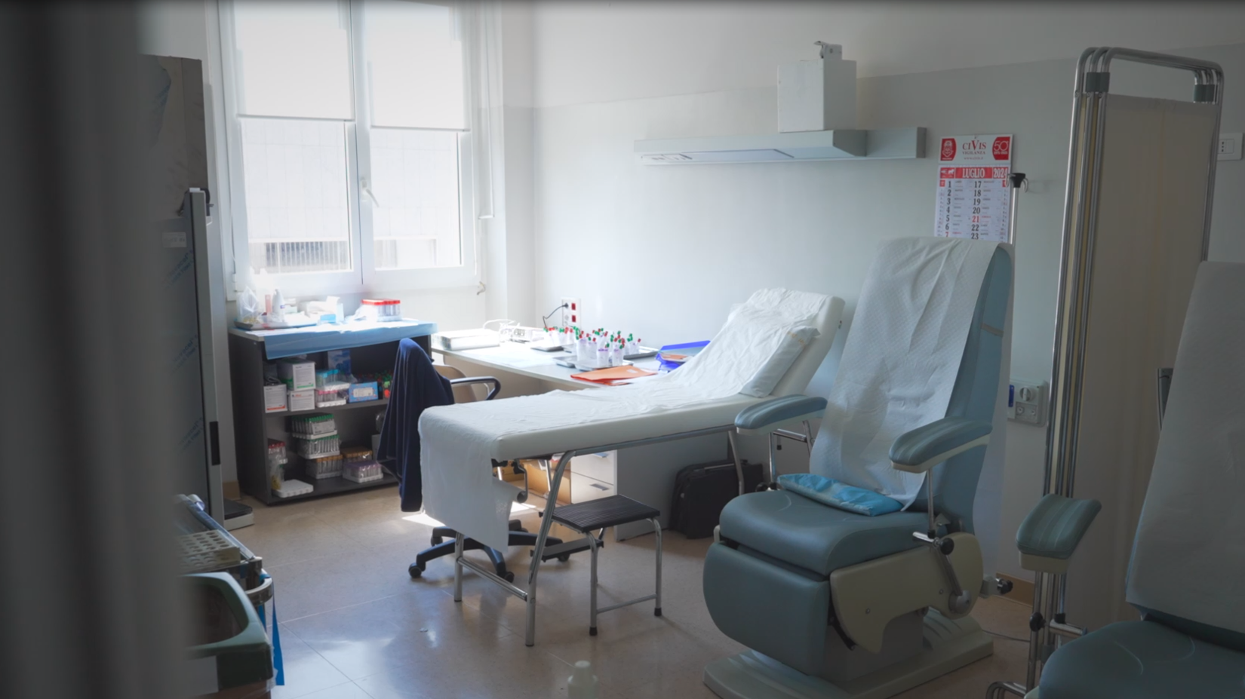
Amyloidosis Research and Treatment Center
Fondazione IRCCS Policlinico San Matteo, Pavia: Italy
Key features of the center:
Dedicated multidisciplinary center for amyloidosis in Pavia
Provides complete multidisciplinary diagnostic work-up including amyloid typing, DNA analysis, cardiologic assessment, neurologic assessment, nutritional evaluation, psychological support, and genetic counseling
Coordinates ‘hub-and-spoke’ network of >40 clinical institutions throughout Italy, coordinated by the Pavia Center, within the Italian Society for Amyloidosis
Center outcomes
∼350 newly diagnosed patients/year
∼ 4,000 clinical evaluations/year
∼40,000 patients’ samples in the center biobank
    Click here to watch a video overview of this center and meet the MDT in Pavia
Data source: courtesy of Prof Laura Obici (Amyloidosis Research and Treatment Center Fondazione IRCCS Policlinico San Matteo, Pavia).

